Slide 1

CMR Technical Campus Department of IT Major Project stage-02 Review-02
Project Title: Automated Infectious Disease Classification using ELECTRA Feature Extraction Driven Ensemble Learning
Project Supervisor:​
Name:​ MD.Sajid Pasha
Designation: Asst. Prof
Presented By:​
Batch No: 09
H. No: 227R1A12A4 Name: L. Akshitha
H. No: 227R1A1268 Name: A.Vivek Vardhan
H. No: 227R1A1276 Name: CH.Srujan​

Slide 2
INDEX
Introduction and overview
Existing System
Existing System- Disadvantages
Proposed system
Proposed system – advantages
Hardware and Software requirements
Novelty of the Project
System Architecture
Modules
UML Diagrams
Source Code
Results
Conclusion & Future Enhancement
References
GitHub Link

Slide 3
INTRODUCTION & OVERVIEW
This project introduces an NLP-based system that automatically classifies infectious disease reports from online news and social media. It starts by cleaning and preparing the text through processes like tokenization, lemmatization, and noise removal. Then, the ELECTRA model is used to extract meaningful features that capture both the grammatical and contextual meaning of the words related to disease outbreaks. These features are analyzed using an ensemble learning approach, which combines several machine learning models to improve accuracy and handle unbalanced data. The proposed system ensures faster and more reliable classification of outbreak data, reducing human effort and helping public health organizations respond quickly and effectively during epidemics and pandemics.

Slide 4
EXISTING SYSTEM
Existing outbreak monitoring systems mostly rely on manual screening and traditional algorithms.
Human experts must filter, read, and categorize reports from thousands of online sources.
Some older systems use keyword searches or rule-based filtering, but these methods lack contextual understanding.
Such systems cannot effectively handle large amounts of multilingual and unstructured data.
Manual monitoring is time-consuming, error-prone, and inefficient.
These limitations often result in missed outbreak signals and delayed detection of diseases.

Slide 5
EXISTING SYSTEM -
DISADVANTAGES
Manual monitoring is highly time-consuming and inefficient, with more than 40% reporting delays recorded in outbreak surveillance.
Traditional algorithms lack contextual understanding and often misclassify or miss subtle signals in textual outbreak data.
Human dependency introduces subjectivity and inconsistency, leading to poor reliability and scalability in real-world outbreak detection.

Slide 6
PROPOSED SYSTEM
The system introduces an automated NLP-based pipeline for classifying infectious disease reports.
The process begins with text preprocessing — including tokenization, lemmatization, stop-word removal, and noise reduction — to clean the raw data.
ELECTRA is used for feature extraction, creating contextual embeddings that capture both syntactic and semantic relationships in the text.
An ensemble classifier processes the embeddings by combining multiple learning models for higher accuracy, robustness, and better handling of class imbalance.
The framework includes a Tkinter-based graphical user interface (GUI) for user interaction.

Slide 7
PROPOSED SYSTEM -ADVANTAGES
Enhances early detection of infectious disease outbreaks by automating the classification of large-scale online reports.
Reduces reliance on manual screening, improving efficiency, consistency, and scalability in disease surveillance.
Supports public health authorities with timely insights, enabling proactive interventions and reducing the economic and health impact of epidemics.

Slide 8

SOFTWARE & HARDWARE REQUIREMENTS
SOFTWARE REQUIREMENTS:
Python 3.12.0
Operating system: Windows
Frontend: TKinter
Database: MySQL
HARDWARE REQUIREMENTS:
Processor: Intel i5
Memory: 1 TB (storage)
RAM: 8 GB

Slide 9
NOVELTY OF THE PROJECT
The novelty of this project lies in its integration of ELECTRA transformer–based contextual feature extraction with ensemble machine learning techniques for automated infectious disease classification from unstructured medical text. Unlike traditional methods that rely on shallow features such as TF-IDF or manual rules, this system captures deep semantic and syntactic information using ELECTRA embeddings and enhances classification robustness through ensemble models like AdaBoost, Extra Trees, TaoTree, and Random Forest. Additionally, the use of SMOTE-based data balancing on transformer features addresses real-world class imbalance in medical datasets. The project delivers a fully automated, scalable, and deployment-ready pipeline using Flask, making it suitable for practical healthcare surveillance and clinical decision-support applications.

Slide 10
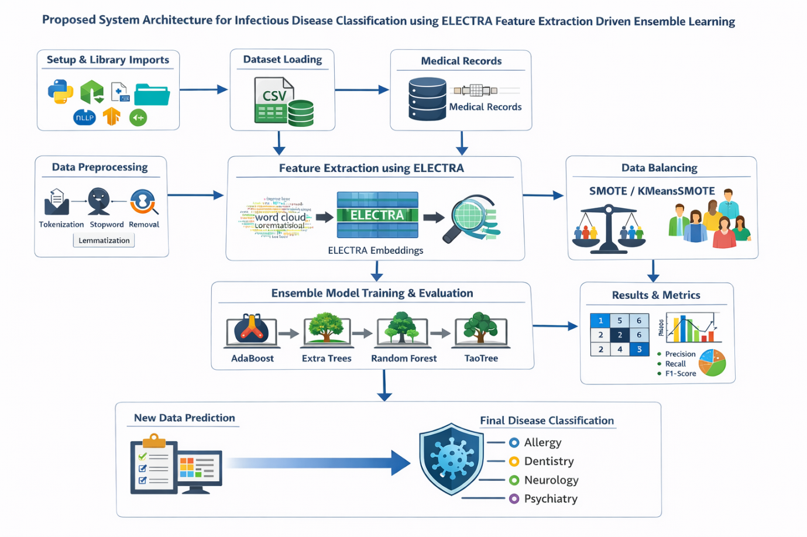
SYSTEM ARCHITECTURE

Slide 11
MODULE-1
NLP Preprocessing
This module handles the cleaning and preparation of raw text data from online disease reports. It performs tokenization, lemmatization, stop-word removal, and noise reduction to ensure that only meaningful textual information is retained. These preprocessing steps standardize the text and improve the performance of downstream machine learning models.

Slide 12
MODULE-2
SMOTE Data Balancing
The Synthetic Minority Oversampling Technique (SMOTE) module addresses the problem of class imbalance in the dataset. It generates synthetic samples for underrepresented disease classes, ensuring balanced data distribution. This helps improve the model’s classification accuracy and prevents bias toward majority classes.

Slide 13
MODULE-3
ELECTRA Feature Extraction
This module uses the ELECTRA model, an advanced transformer-based encoder, to generate contextual embeddings from preprocessed text. ELECTRA captures both syntactic and semantic nuances, providing richer and more accurate text representations than traditional embeddings. These high-quality feature vectors form the input for the ensemble classifier.

Slide 14
MODULE-4
Ensemble Classifier
The ensemble learning module combines multiple base classifiers such as Support Vector Machine (SVM) and Random Forest to improve prediction performance. A meta-learner integrates the outputs of these models to produce the final classification. This approach enhances accuracy, robustness, and generalization across diverse disease reports.

Slide 15
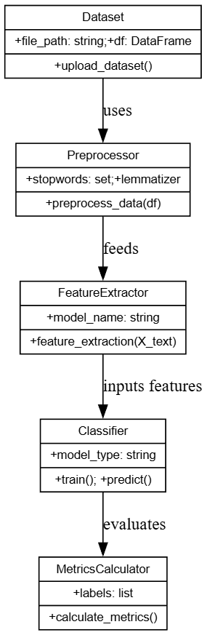
UML DIAGRAMS-
1.CLASS DIAGRAM

Slide 16
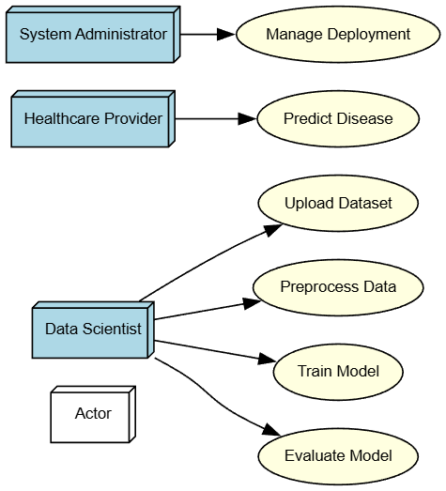
2.USECASE DIAGRAM

Slide 17
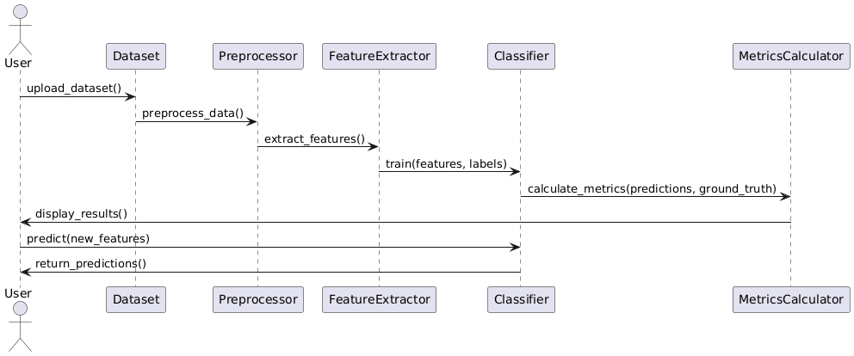

3.SEQUENCE DIAGRAM

Slide 18
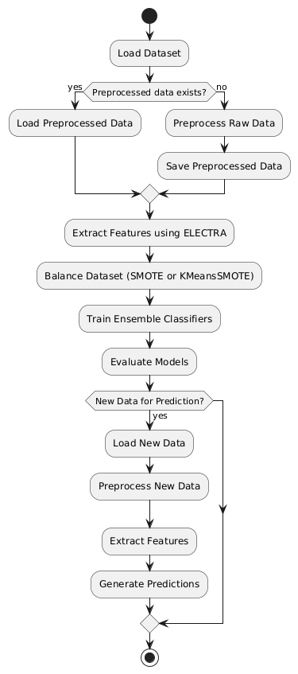
4.ACTIVITY DIAGRAM

Slide 19
SOURCE CODE
Import Libraries
import pandas as pd
import numpy as np
import torch
import nltk
from tqdm import tqdm
from sklearn.model_selection import train_test_split from sklearn.ensemble import RandomForestClassifier
from sklearn.metrics import accuracy_score, classification_report from sklearn.preprocessing import LabelEncode
from transformers import AutoTokenizer, AutoModel from nltk.corpus import stopwords from nltk.tokenize import word_tokenize from nltk.stem import WordNetLemmatizer
# Download NLTK data nltk.download('punkt') nltk.download('stopwords') nltk.download('wordnet')

Slide 20
2. Load Dataset
def load_data(path): df = pd.read_csv(path)
df = df.drop(columns=["Unnamed: 0"], errors='ignore’) df = df.dropna() df = df.reset_index(drop=True) return df df = load_data("Dataset/mtsamples.csv")
3. Text Preprocessing
lemmatizer = WordNetLemmatizer() stop_words = set(stopwords.words('english')) def clean_text(text): text = str(text).lower() tokens = word_tokenize(text) tokens = [ lemmatizer.lemmatize(word) for word in tokens if word.isalnum() and word not in stop_words ] return " ".join(tokens) df["clean_text"] = df["description"].apply(clean_text)

Slide 21
5. ELECTRA Feature Extraction def electra_embeddings(texts, batch_size=16): tokenizer = AutoTokenizer.from_pretrained("google/electra-base-discriminator") model = AutoModel.from_pretrained("google/electra-base-discriminator") model.eval() all_embeddings = [] for i in tqdm(range(0, len(texts), batch_size), desc="Extracting Features"): batch = texts[i:i+batch_size] inputs = tokenizer(batch, padding=True, truncation=True,
return_tensors="pt") with torch.no_grad(): outputs = model(**inputs) embeddings = outputs.last_hidden_state.mean(dim=1) all_embeddings.append(embeddings.numpy()) return np.vstack(all_embeddings) X = electra_embeddings(df["clean_text"].tolist()) y = df["label"].values

Slide 22
6. Train-Test Split
X_train, X_test, y_train, y_test = train_test_split( X, y, test_size=0.2, random_state=42, stratify=y)
7. Train Model
rf_model = RandomForestClassifier(n_estimators=100, random_state=42) rf_model.fit(X_train, y_train)
8. Evaluation y_pred = rf_model.predict(X_test) accuracy = accuracy_score(y_test, y_pred) print("Accuracy:", accuracy) print("\nClassification Report:") print(classification_report(y_test, y_pred))

Slide 23
9. Prediction Function def predict_text(text): text_clean = clean_text(text) emb = electra_embeddings([text_clean]) pred = rf_model.predict(emb) return label_encoder.inverse_transform(pred)[0]
10. Test Prediction sample_text = "Patient has chest pain and shortness of breath" prediction = predict_text(sample_text) print("\nSample Input:", sample_text) print("Predicted Medical Specialty:", prediction)

Slide 24


RESULTS
Home page of Clinical NLP Trails
Sign up page of Clinical NLP Trails

Slide 25

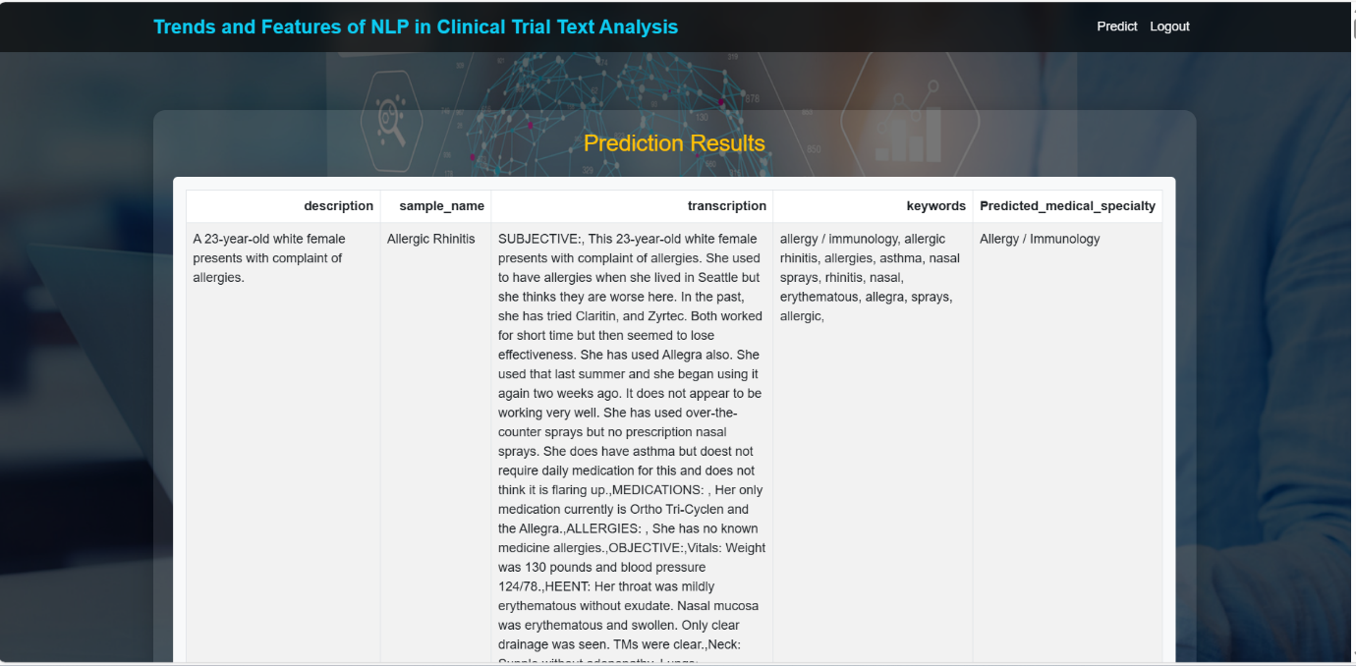
User login page of Clinical NLP Trails
Real time predictions of Clinical NLP Trails

Slide 26
Conclusion & Future Enhancement
This project presents a robust and intelligent framework for clinical text classification. It leverages ELECTRA-based word embeddings and ensemble learning techniques to accurately predict medical specialties from unstructured MTSamples reports.
Additionally, the application of SMOTE addresses class imbalance and ensures fair representation of minority classes.
The ETC model significantly outperformed other classifiers such as AdaBoost (13.9%), TaoTree (20.1%), and Random Forest (86.3%).
Overall, the framework demonstrates high generalizability, reproducibility, and practical applicability.
It provides a strong foundation for automated medical specialty prediction in real-world clinical transcription systems.

Slide 27
REFERENCES
M. Wang, Z. Wei, M. Jia and L. Chen, “Deep Learning Model for Multi-Classification of Infectious Diseases from Unstructured Electronic Medical Records,” BMC Medical Informatics and Decision Making, vol. 22, no. 1, pp. 1–12, 2022, doi: 10.1186/s12911-022-01776-y.
S. Kumar, R. Patel and A. Sharma, “Natural Language Processing for Infectious Disease Detection: A Systematic Review,” American Journal of Infection Control, vol. 52, no. 4, pp. 456–465, 2024, doi: 10.1016/j.ajic.2024.01.015.
G. Miolo, G. Mantoan and C. Orsenigo, “ELECTRAMed: A Pre-trained Language Model for Biomedical NLP,” arXiv preprint arXiv:2104.09585, 2021, doi: 10.48550/arXiv.2104.09585.

Slide 28
GITHUB LINK
https://github.com/arnojivivekvardhan22/Automatic-Infectious-Disease.git

Slide 29
THANKYOU

